Slide 1
Lecture 8
Half-Range Fourier series

Slide 2
Objective
To discuss about even extension and odd extension
To find series expression of any periodic function

Slide 3
Half-Range Fourier series
If f(x) and f ′(x) are piecewise continuous functions defined on the interval 0 ≤ x ≤ L, then f(x) can be extended into an even periodic function, F, of period 2L, such that f (x) = F(x) on the interval [0, L], and whose Fourier series is, therefore, a cosine series.
Similarly, f(x) can be extended into an odd periodic function of period 2L, such that f (x) = F(x) on the interval (0, L), and whose Fourier series is, therefore, a sine series. The process that such extensions are obtained is often called cosine /sine series half-range expansions. A Fourier series for f (x), valid on [0, L], may be constructed by extension of the domain to [–L, L].

Slide 4
Definition of Half-Range Fourier series
An odd extension of f(x) of the period 2L leads to a Fourier sine series:
where and
An even extension of f(x) of period 2L leads to a Fourier cosine series:
where and

Slide 5
Example of Half-Range Fourier series
Example: Find the Half range Fourier sine and cosine series for
Solution:
Step 1: Half range Fourier sine series (Odd periodic extension)

Slide 6
Example of Half-Range Fourier series
Step 2:
Here, T=2L=2, hence L=1
An odd extension of f (x) is required to the interval [–1, 1]. a_{n} = 0 for all n.
Sign | D | I
+
- | 2
+ | 0

Slide 7
Example of Half-Range Fourier series(continued)
Step 3:
Therefore the half range Fourier sine series for f (x) on [0, 1] is
Now, for Half range Fourier cosine series
Step 1: Half range Fourier cosine series (Even periodic extension)

Slide 8
Example of Half-Range Fourier series
Step 2:
Here, T=2L=2, hence L=1
An even extension of f (x) is required to the interval [–1, 1]. b_{n} = 0 for all n.
Sign | D | I
+
- | 2
+ | 0

Slide 9
Example of Half-Range Fourier series(continued)
Step 3:
Therefore the half range Fourier cosine series for f (x) on [0, 1] is

Slide 10
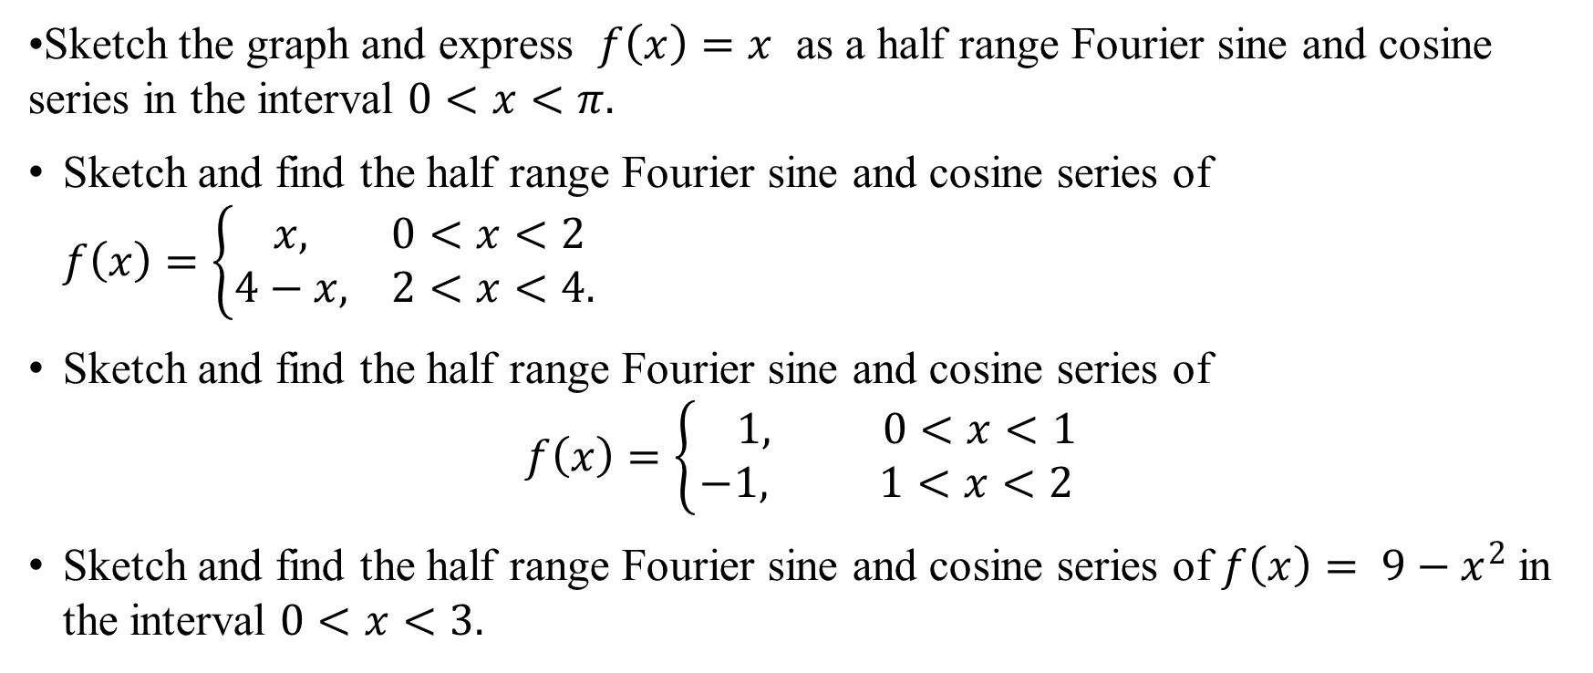
Sample Exercise
Sketch the graph and express $f\left(x\right)=x$ as a half range Fourier sine and cosine series in the interval $0<x<π.$
Sketch and find the half range Fourier sine and cosine series of $f\left(x\right)=\left\{\begin{aligned} x, 0<x<2 \\ 4−x, 2<x<4.\end{aligned}\right.$
Sketch and find the half range Fourier sine and cosine series of
$$f\left(x\right)=\left\{\begin{aligned} 1, 0<x<1 \\ −1, 1<x<2\end{aligned}\right.$$
Sketch and find the half range Fourier sine and cosine series of $f\left(x\right)= 9−x^{2}$ in the interval $0<x<3.$

Slide 11
Sample MCQ
For even extension which formula should be used?
half range sine series b) half range cosine series c) both d) none
For odd extension which formula should be used?
a) half range sine series b) half range cosine series c) both d) none

Slide 12
Outcome
After this lecture students will be able
to sketch odd extension
to sketch even extension
to calculate half range Fourier sine and cosine series.

Slide 13
Next class
Fourier integral

